Slide 1
Principles of Database Systems (CS307) Lecture 8: Function & Procedure
Ran Cheng
Department of Computer Science and Engineering
Southern University of Science and Technology
Most contents are from slides made by Dr. Yuxin Ma, Stéphane Faroult and the authors of Database System Concepts (7th Edition).
Their original slides have been modified to adapt to the schedule of CS307 at SUSTech.
Notes:
In this chapter, I will introduce how to retrieve data from one table. Just from one table. I will introduce how to retrieve data from multiple table in next chapter.

Slide 2
Function

Slide 3
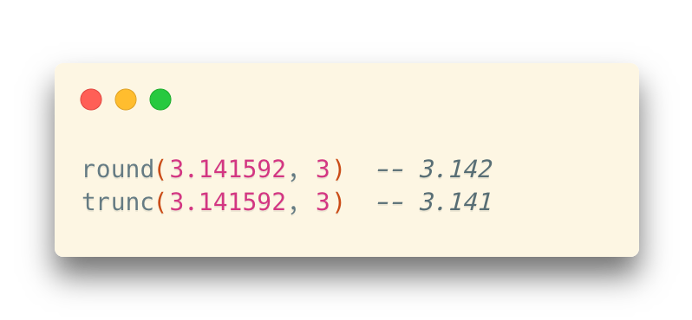
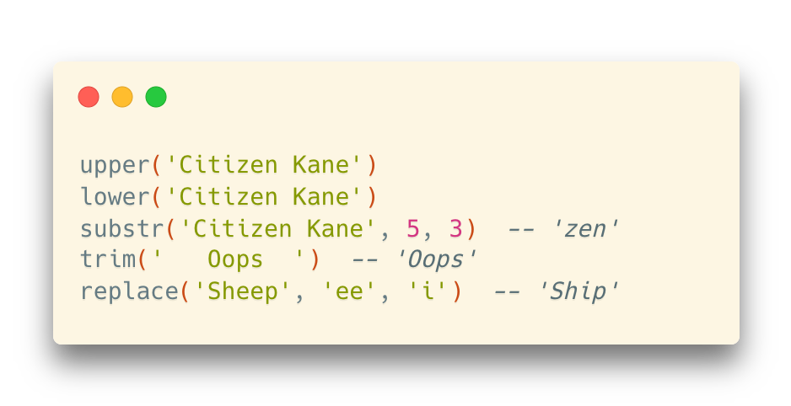
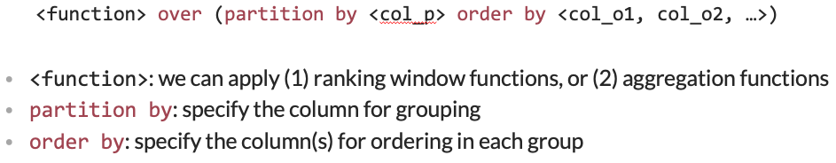
Built-in Functions
Most DBMS provides a series of built-in functions
E.g., Scalar function, aggregation function, window function

Slide 4
Self-defined Function
Sometimes the built-in functions cannot fulfill our requirements
And the power of declarative language (SQL) is not enough
Most DBMS implement a built-in, SQL-based programming language
A procedural extension to SQL

Slide 5
Procedural vs. Declarative
Two different programming paradigms
Imperative: Describe the algorithms step-by-step (命令式编程)
Procedural: C (and many other legacy languages)
Object-oriented: Java
Declarative: Describe the result without specifying the detailed steps (声明式编程)
(Pure) declarative: SQL, Regular Expressions, Markup (HTML, XML), CSS
Functional: Scheme, Haskell, Scala, Erlang
Logic programming: Prolog

Slide 6
Procedural vs. Declarative
E.g., How can we get a cup of tea?
In a procedural way:
In a declarative way:

Slide 7
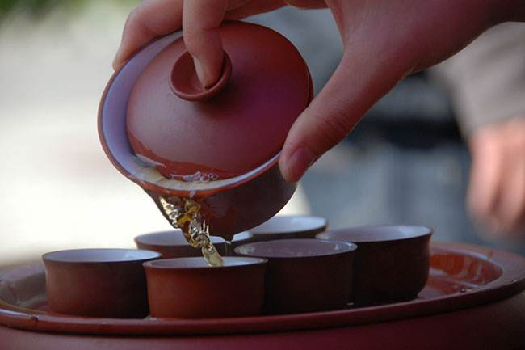
Procedural vs. Declarative
E.g., How can we get a cup of tea?
In a procedural way:
In a declarative way:
1. Get a cup
2. Get some tea
3. Get some hot water
4. Put tea into the cup
5. Pour hot water into the cup
6. return tea;

Slide 8
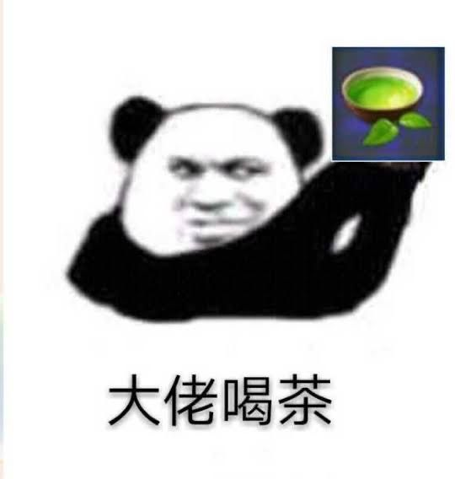
Procedural vs. Declarative
E.g., How can we get a cup of tea?
In a procedural way:
In a declarative way:
You don’t really need to know how to make a cup of tea
The system can do it in a black-box manner
1. Get a cup
2. Get some tea
3. Get some hot water
4. Put tea into the cup
5. Pour hot water into the cup
6. return tea;
<a cup of tea/>

Slide 9

Procedural vs. Declarative
E.g., Find all Chinese movies before 1990 in the movies table?
In a procedural way:
In a declarative way:
You don’t really need to know how to filter the table
The DBMS system can do it in a black-box manner
1. Read the movies table into the memory
2. For each row i in the table, repeat:
2.1 In row i, read the value of the column “country”
2.2 if …
select * from movies where country = ‘cn’ and year_released < 1990

Slide 10
Procedural vs. Declarative
Benefits in declarative languages
No need to understand the details
The systems take in charge of all the details
Easier to use than imperative programming
More user-friendly
Problem in declarative languages
Cannot specify the control flow of a program
“If there is no such command as <a cup of tea/>, you need to create it by yourself”

Slide 11





Procedural Extension to SQL
Many DBMS products provide a proprietary procedural extension to the standard SQL
Transact-SQL (T-SQL)
PL/SQL
PL/PGSQL
(No specific name)
(Not supported)
… well, sometimes SQLite is even not considered a DBMS

Slide 12
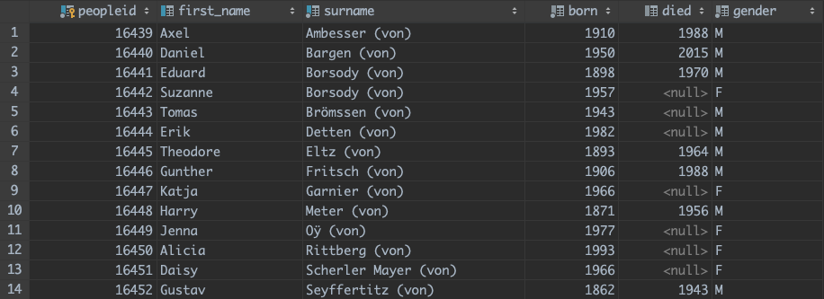
Function in (Postgre)SQL
Example: Display the full name for people with “von”
When introducing update, we have modified the names starting with “von” into “… (von)” for ordering

Slide 13
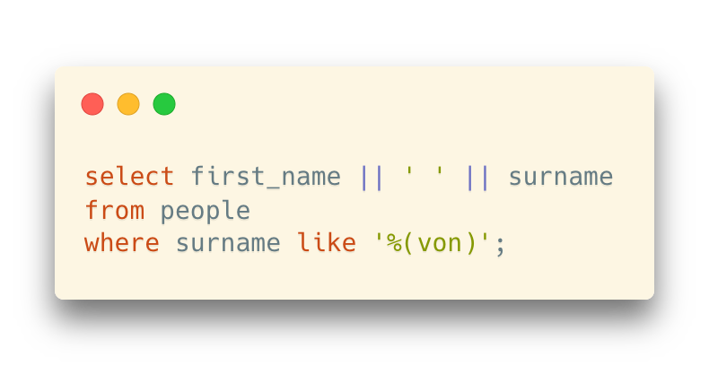
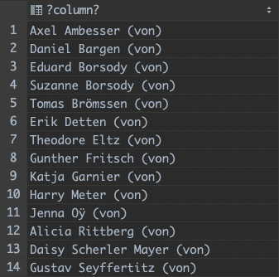
Function in (Postgre)SQL
If we simply concatenate the first name and the last name, it looks like this:
A little bit weird format (a trailing “von”)

Slide 14
Function in (Postgre)SQL
Question: How can we restore the format into “first_name von surname”?
String operations

Slide 15
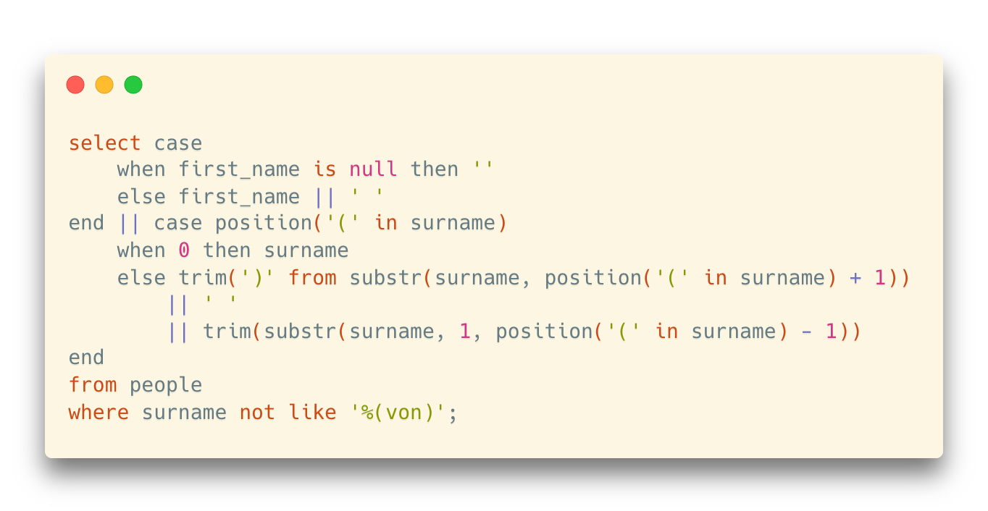
Function in (Postgre)SQL
Question: How can we restore the format into “first_name von surname”?
String operations

Slide 16
Function in (Postgre)SQL
Question: How can we restore the format into “first_name von surname”?
String operations
Then, how can we store this part to reuse it in the future?

Slide 17
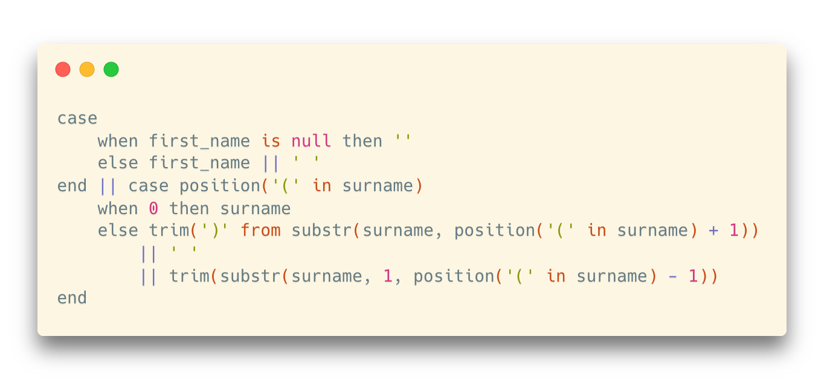

Function in (Postgre)SQL
“Copy and paste” is not a good habit
Whenever you have painfully written something as complicated, which is pretty generic, you'd rather not copy and paste the code every time you need it

Slide 18
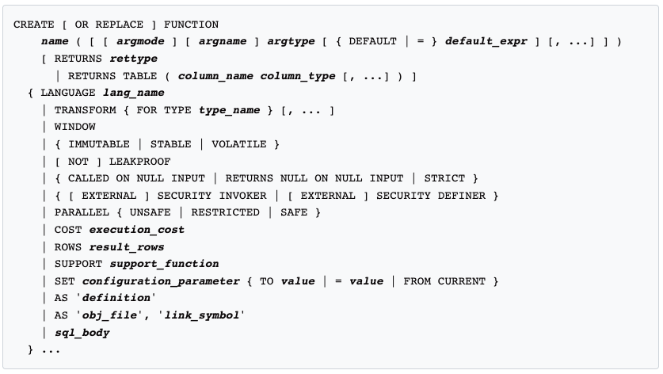
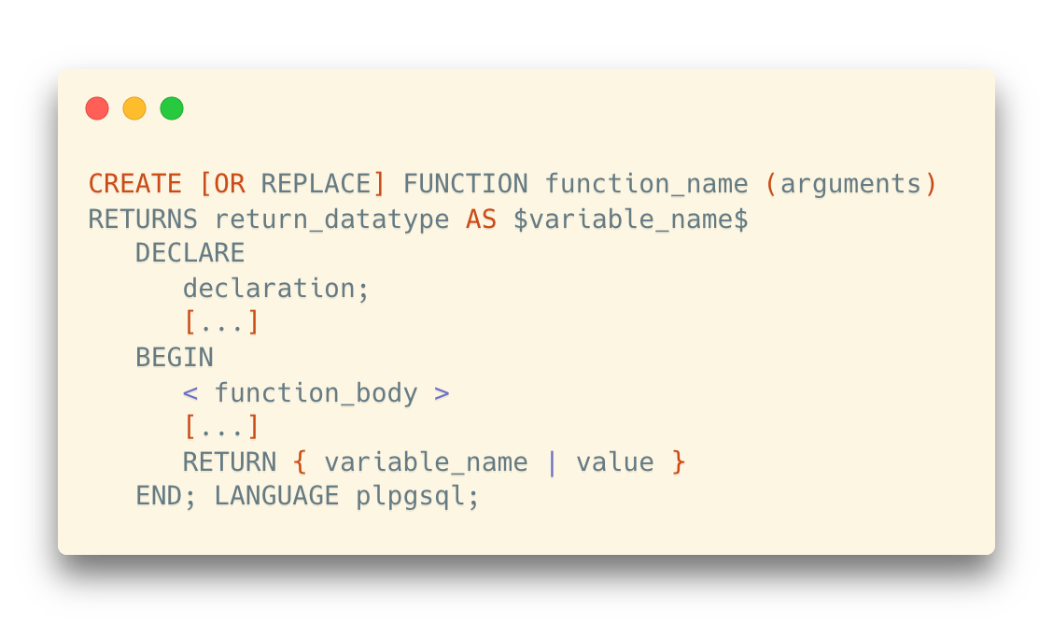
Function in (Postgre)SQL
Store for Reuse
In PostgreSQL, we can store the expression and reuse it in another context
Self-defined Function
create function
…or, a simpler version
https://www.postgresql.org/docs/current/sql-createfunction.html

Slide 19
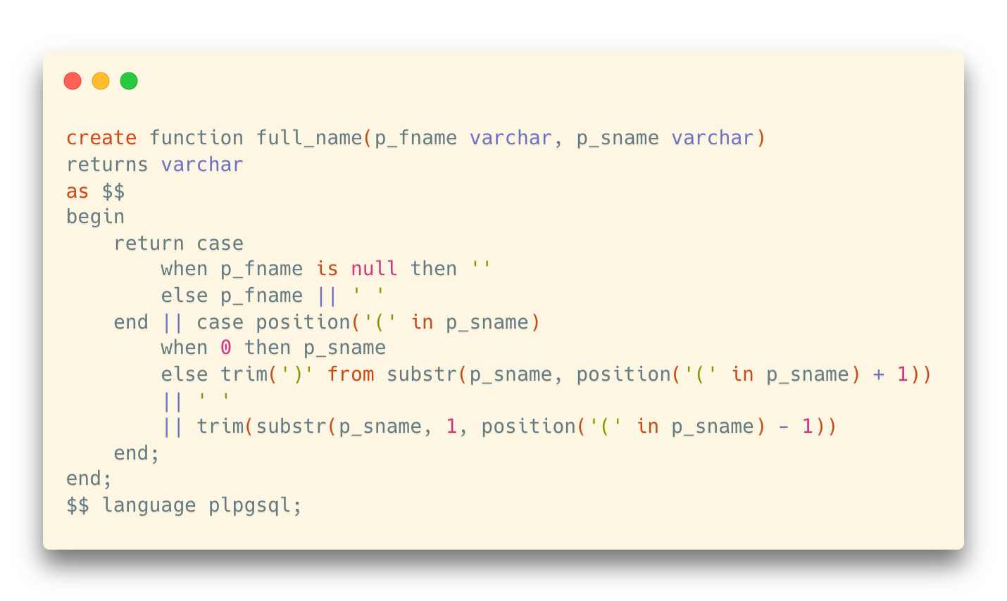
Function in (Postgre)SQL
How do we rewrite the name conversion expression into a function?

Slide 20
Function in (Postgre)SQL
How do we rewrite the name conversion expression into a function?
Function name and the parameter list
Format for variables and parameters: [name] [type]

Slide 21
Function in (Postgre)SQL
How do we rewrite the name conversion expression into a function?
Return type

Slide 22
Function in (Postgre)SQL
How do we rewrite the name conversion expression into a function?
Body

Slide 23
Function in (Postgre)SQL
How do we rewrite the name conversion expression into a function?
A very simple body: return the value of an expression

Slide 24
Function in (Postgre)SQL
How do we rewrite the name conversion expression into a function?
A very simple body: return the value of an expression
Procedural extensions provide all the bells and whistles in a true (procedural) programming languages, such as:
Variables
Conditions
Loops
Arrays
Error management
…

Slide 25
Function in (Postgre)SQL
How do we rewrite the name conversion expression into a function?
Language Type
PostgreSQL supports 4 procedural languages:
PL/pgSQL, PL/Tcl, PL/Perl, and PL/Python
Tcl, Perl, and Python are famous scripting languages in case you don’t know

Slide 26
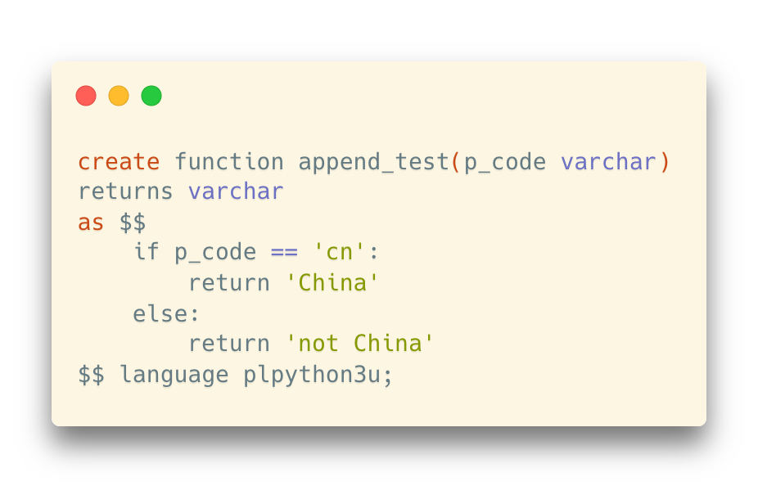
Function in (Postgre)SQL
How do we rewrite the name conversion expression into a function?
Yes, we can even use Python to write functions
Language Type
PostgreSQL supports 4 procedural languages:
PL/pgSQL, PL/Tcl, PL/Perl, and PL/Python
Tcl, Perl, and Python are famous scripting languages in case you don’t know

Slide 27
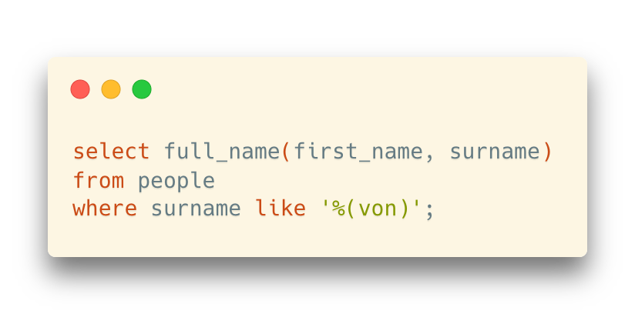
Function in (Postgre)SQL
Once your function is created, you can use it as if it were any built-in function.

Slide 28
Function in (Postgre)SQL
We can run select queries in functions
Example: design a function “get_country_name” to transform the country codes into country names based on the countries table

Slide 29
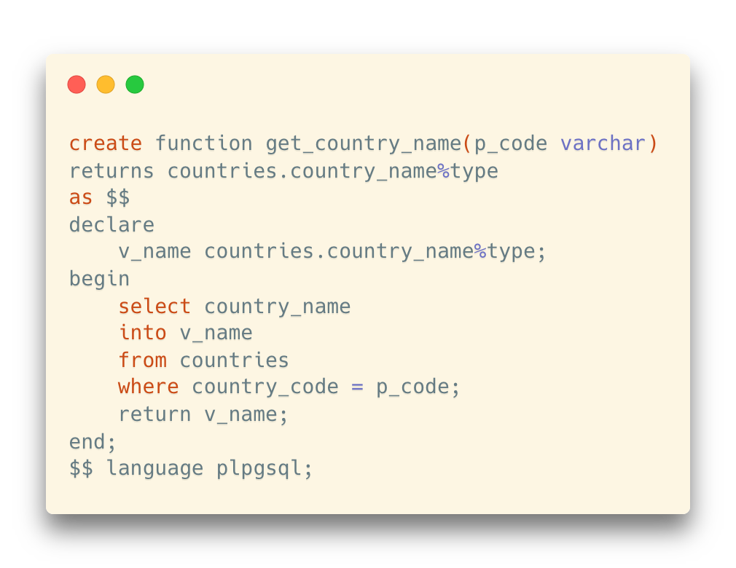
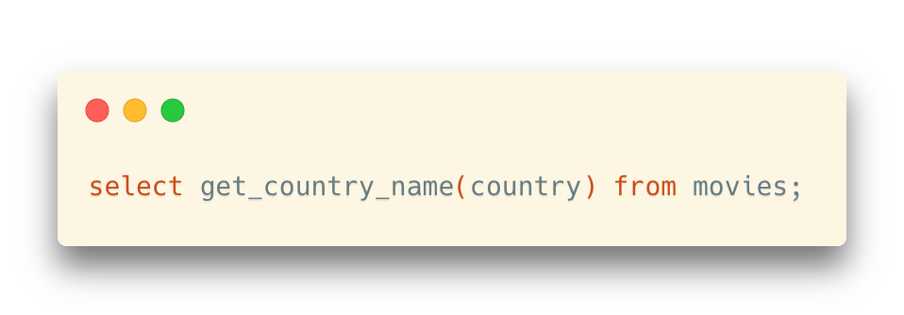
Function in (Postgre)SQL
We can run select queries in functions
Example: design a function “get_country_name” to transform the country codes into country names based on the countries table

Slide 30
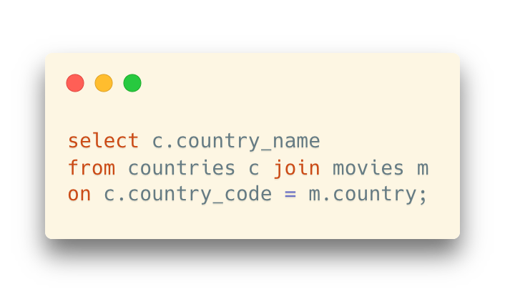
Function in (Postgre)SQL
We can run select queries in functions
Example: design a function “get_country_name” to transform the country codes into country names based on the countries table
… seems to be an easy way to get rid of join operations?

Slide 31
Function in (Postgre)SQL
“Cultural Mismatch”
Here we have a problem, because there is a big cultural gap between the relational mindset and procedural processing.
A “look-up function” forces a “one row at a time” join which in most cases will be dreadful
For each row in movies, the select query in get_country_name() is executed once

Slide 32


Comment on Procedural SQL (PL/SQL)
Tom Kyte, who is a Senior Technology Architect at Oracle, says that his mantra is:
You should do it in a single SQL statement if at all possible.
If you cannot do it in a single SQL statement, then do it in PL/SQL (as little PL/SQL as possible!)
And some other suggestions (from your lecturer):
You should ask for help from someone more experienced than you
Stackoverflow, forums, Google, etc.

Slide 33
Procedure

Slide 34
Functions vs. Procedures
Generally,
“Function” comes from mathematics
… which calculates a value with a given input (or to say, map a value to another)
Thus, functions always have a return value
”Procedure” comes from programming
… which is used to describe a set of instructions that will be executed in order
… and does NOT (necessarily) have a return value
However,
Sometimes, the two terms are used for representing the same thing
e.g., procedures are called functions as well
You need to be careful when meeting both terms
Always identify the exact meaning of each term and see whether they have different or the same meaning(s)

Slide 35
Functions and Procedures in (Postgre)SQL
It follows the general definition of functions and procedures
Function: return a value
Procedure: return NO value
However,
For some historical reasons, PostgreSQL actually has no implementation specifically for procedures
It shares the same mechanism with functions and treats the procedures as “void functions”
* But for some other database systems, there are separate implementations for functions and procedures

Slide 36
When to Use Procedures
For business logics
One requirement may need a series of SQL querys and statements
Example: Insert a new movie into the databases
movies table: basic information for the movie
countries table: transformation between country names and codes
people table: new actors / directors
credits table: new credit information
Problem: Update all the tables? Input validation? Code reuse? Security?

Slide 37
When to Use Procedures
For the requirement of adding a movie:
We may have a series queries to execute when inserting only one movie
How about one call for all the processes?
Benefit 1: Network overhead
When running multiple queries, you are going to waste time chatting over the network with the remote server
Benefit 2: Security
You can prevent users from modifying data otherwise than by calling carefully written and well tested procedures

Slide 38
Example: Adding a New Movie
The information provided for a new movie:
Title
Year
Country Name
Note: Name, not code. Country codes are not user-friendly
E.g. Which country does “at” represent? ”al”? “ma”? “li”?
Director
Actor 1
Actor 2
Let’s only consider a situation where only one director and at most two actors are allowed
It will be more difficult when the number of people are flexible

Slide 39
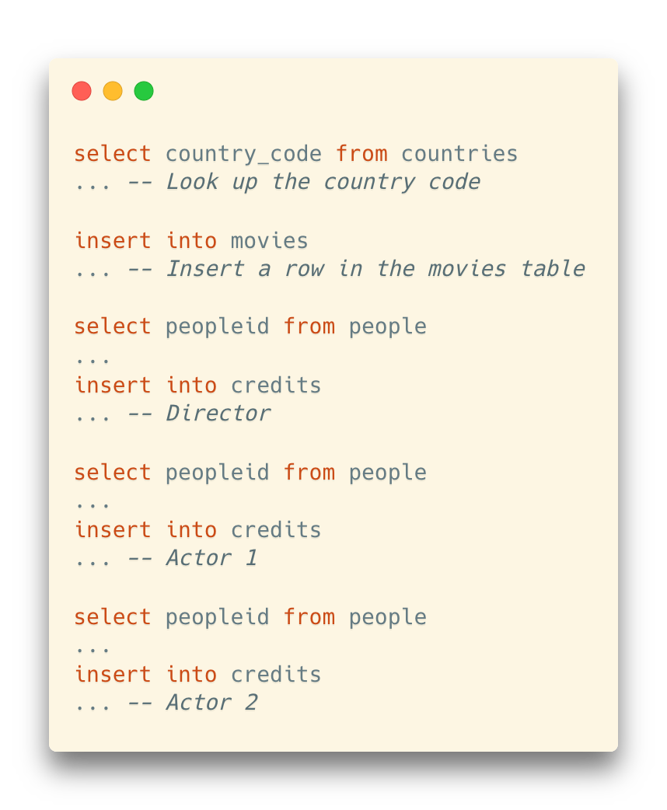
A Typical Process
Insert and check the values, constraints, existence, duplicates, etc
A series of inter-related statements

Slide 40
A Typical Process
How can we pack them into a single execution unit?
Minimize the communication between the client program we are using and the database server
Client program = DataGrip, psql, …

Slide 41
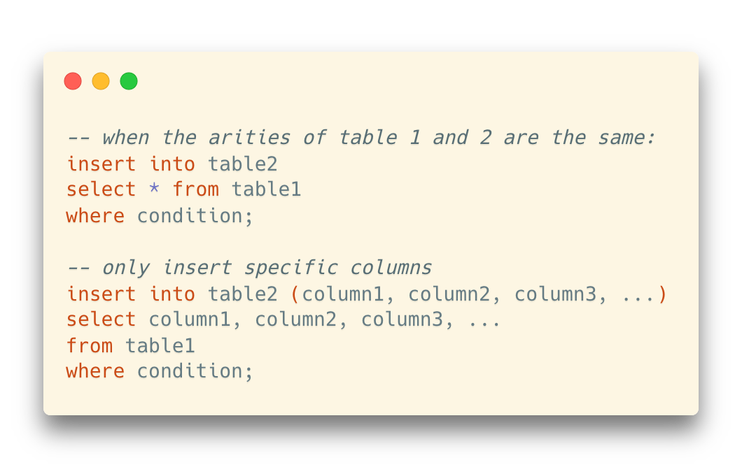
insert into select
One thing to optimize: insert into … select

Slide 42
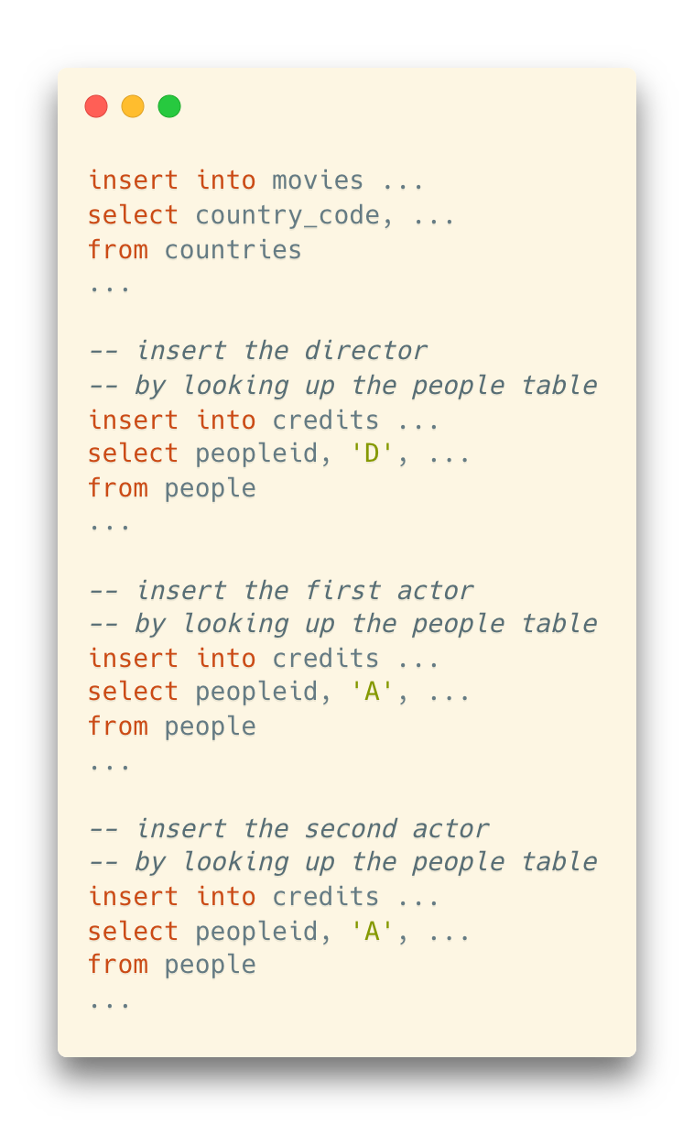
Optimize the Insertion
Use insert into select

Slide 43
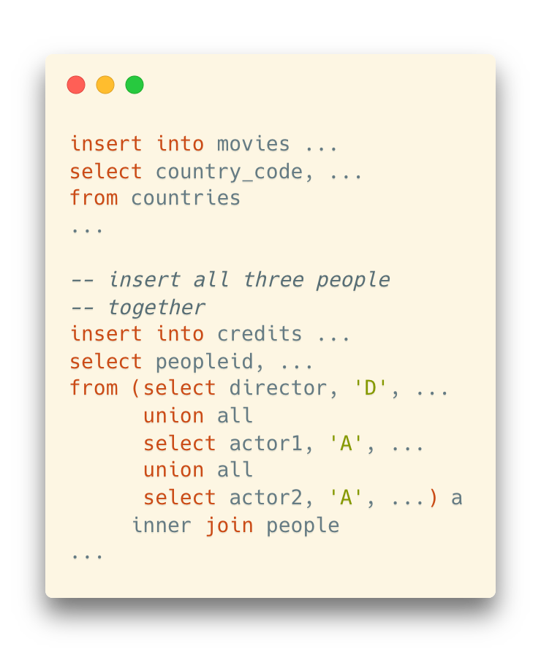
Further Optimize the Insertion
Use insert into select
Combine the queries of people

Slide 44
Further Optimize the Insertion
More improvements:
Check whether a row in movies is correctly inserted
Use insert into select
Combine the queries of people
Check whether rows in credits are correctly inserted

Slide 45
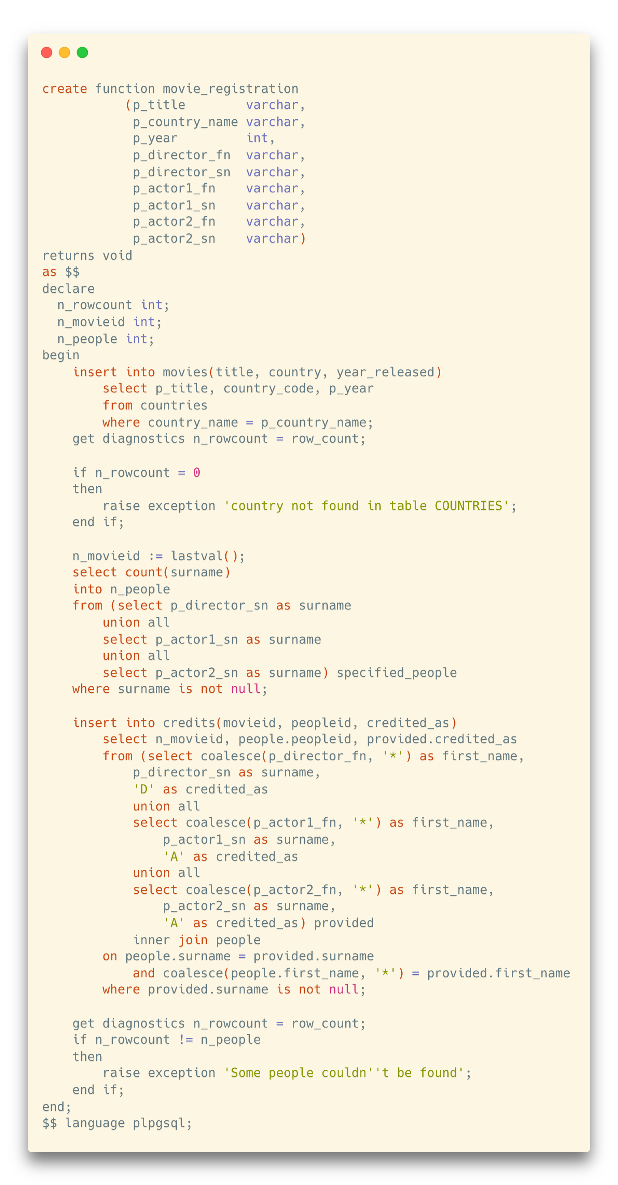
The Procedure

Slide 46
The Procedure
Check whether rows in credits are correctly inserted
Check whether a row in movies is correctly inserted

Slide 47
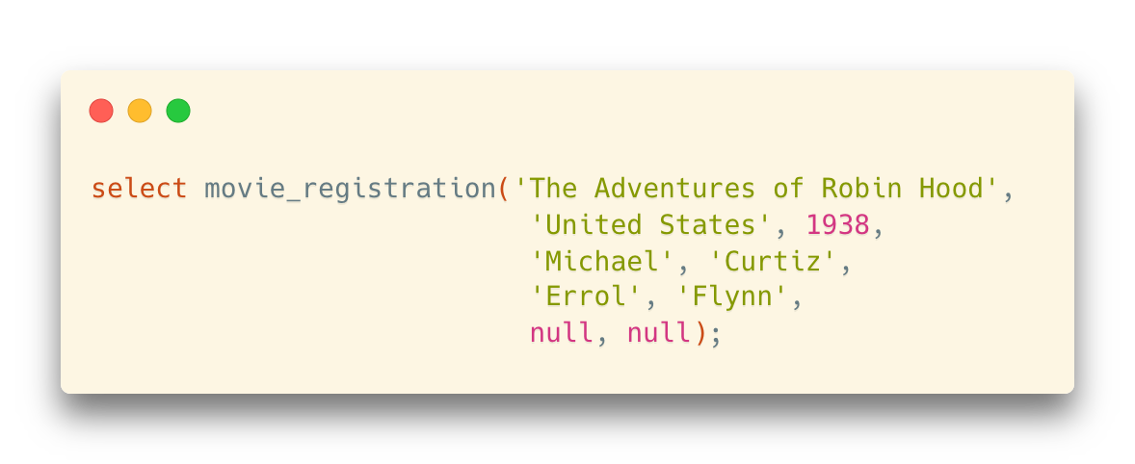
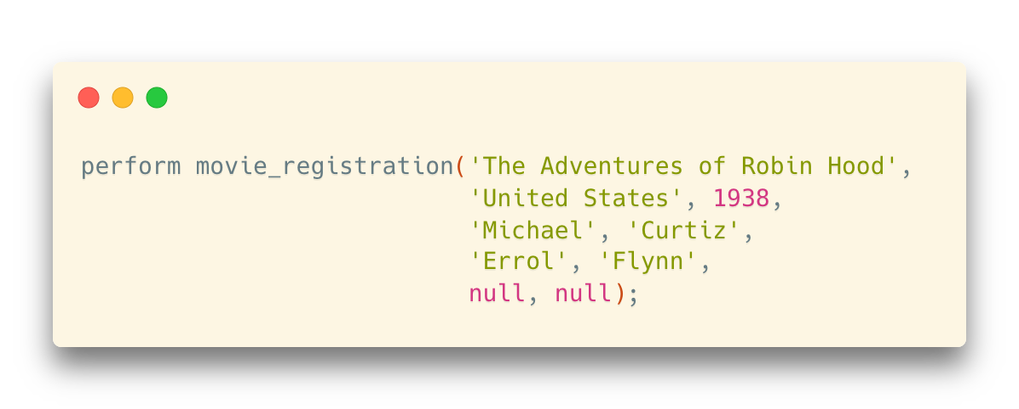
Calling Procedures
(In PostgreSQL) We can call the procedure interactively by calling it from a SELECT statement (that will return nothing)
We can also call a procedure from another procedure

Slide 48
More to Read
We may not cover all the details in functions in the theoretical session, so here are some more materials on procedural programming in PostgreSQL:
Lab tutorial on Functions
Please read it before your next lab sessions
Chapter 5.2 “Functions and Procedures,” Database System Concepts (7th Edition)
Chapter 43 “PL/pgSQL,” PostgreSQL Documentation
https://www.postgresql.org/docs/current/plpgsql.html

